Slide 1

Notes:
Greetings/additional statements - Title

Slide 2

Notes:
My name is Ivan Wilson, FED at Innate, a digital agency

Slide 3

Notes:
(Innate location) In Washington, DC (national capital) in Dupont Circle district

Slide 4
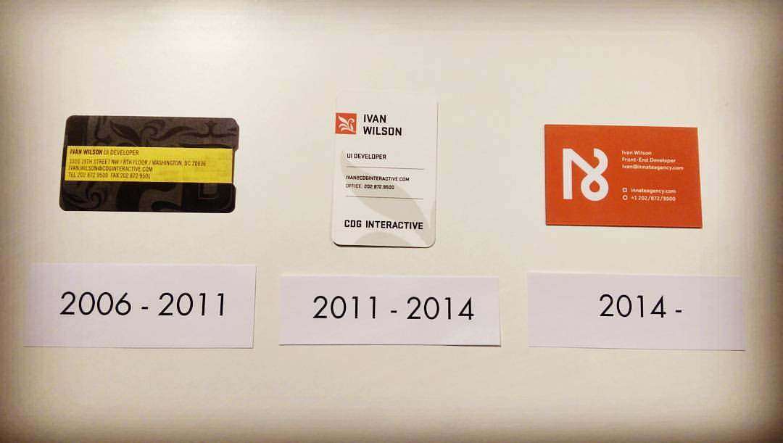
Notes:
10th Anniversary in April

Slide 5
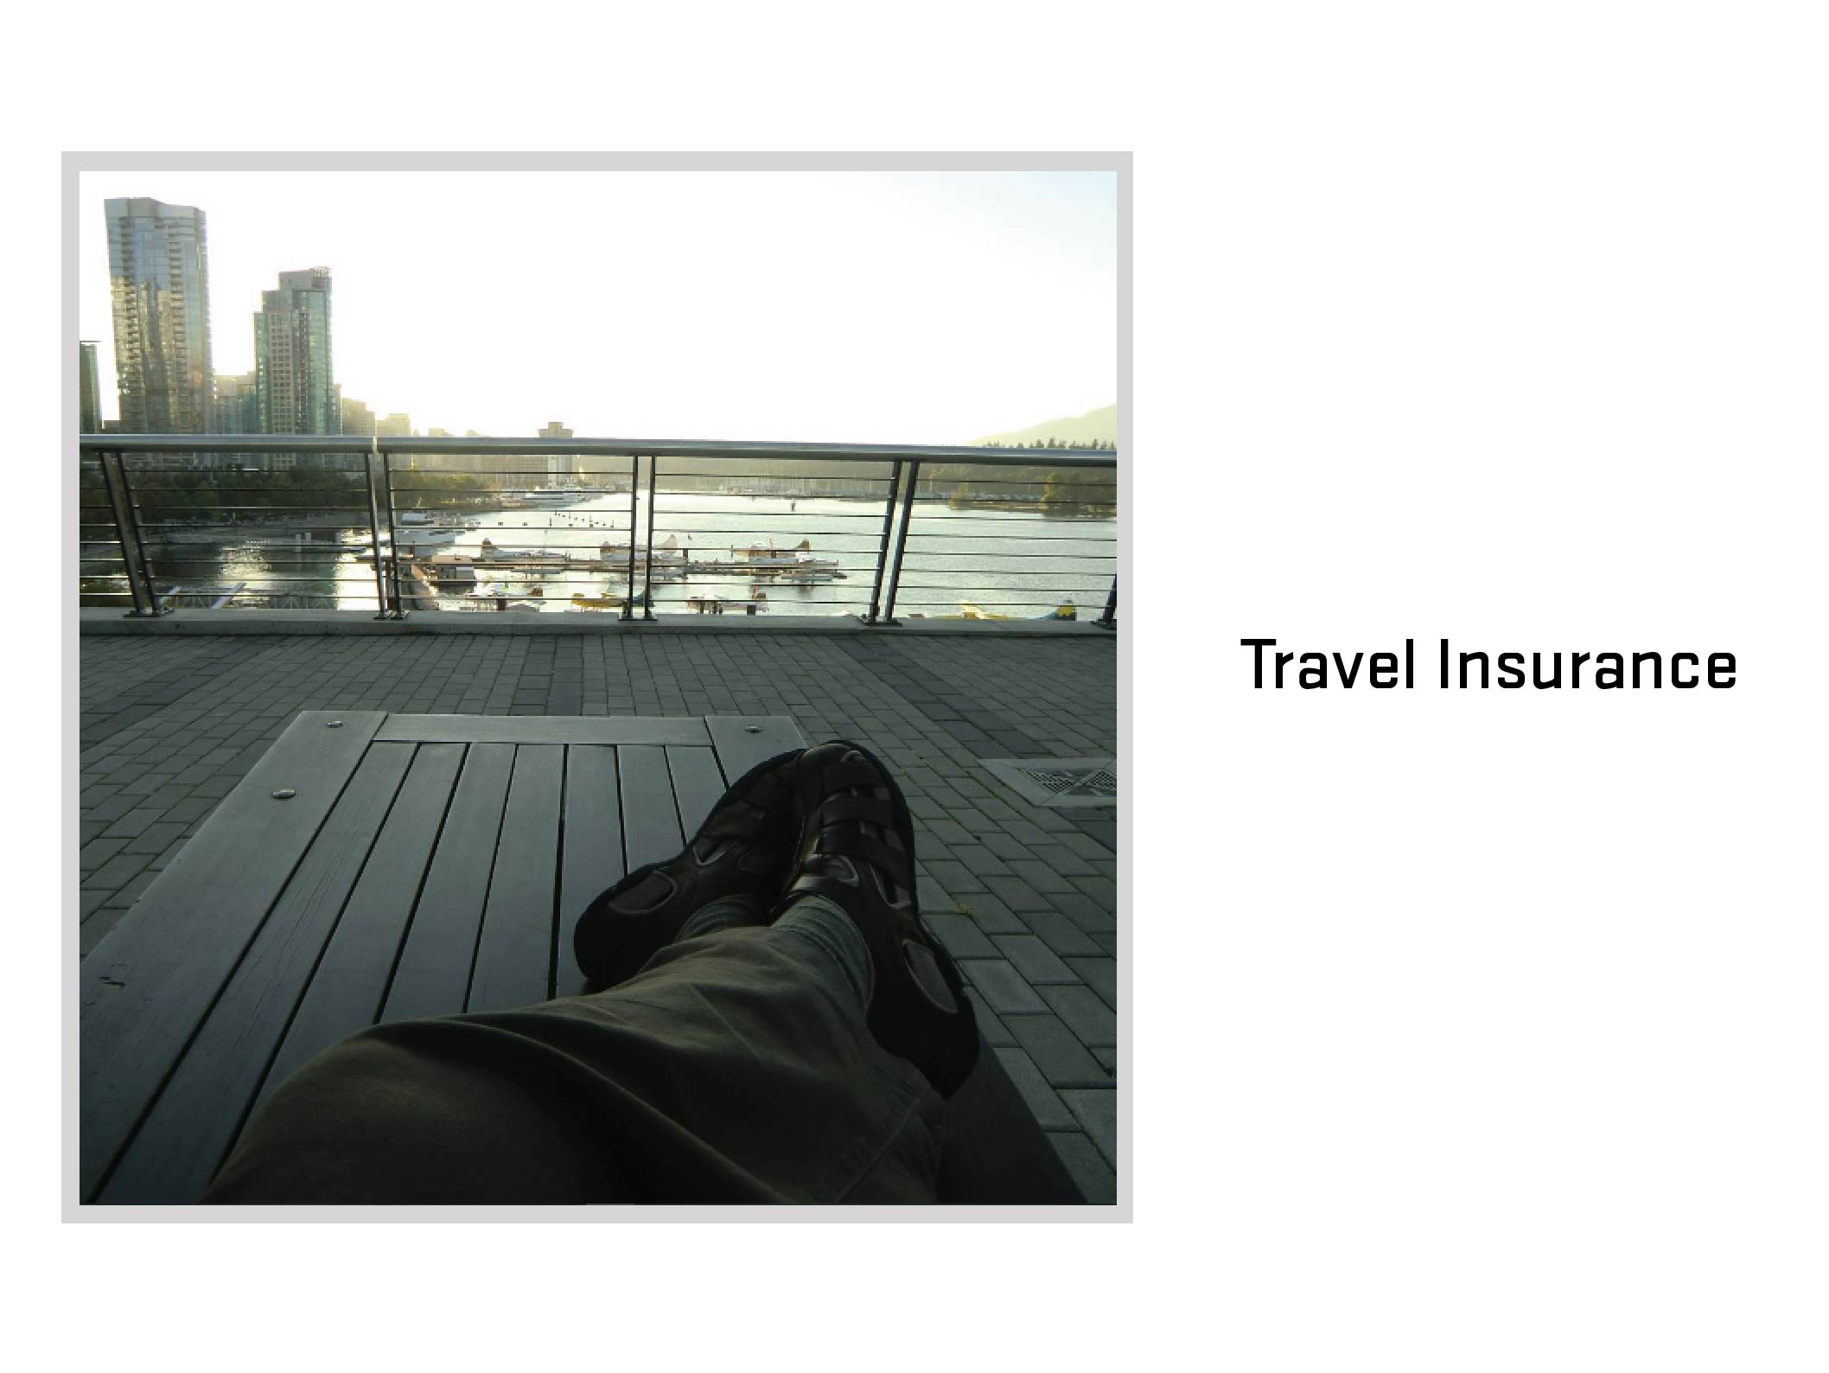
Notes:
Travel Insurance
What is travel insurance? (Ask audience)

Slide 6
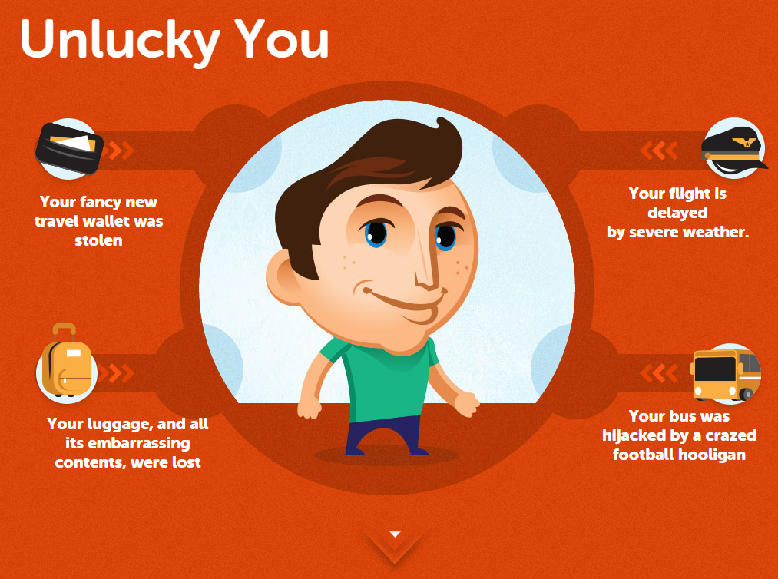

Slide 7
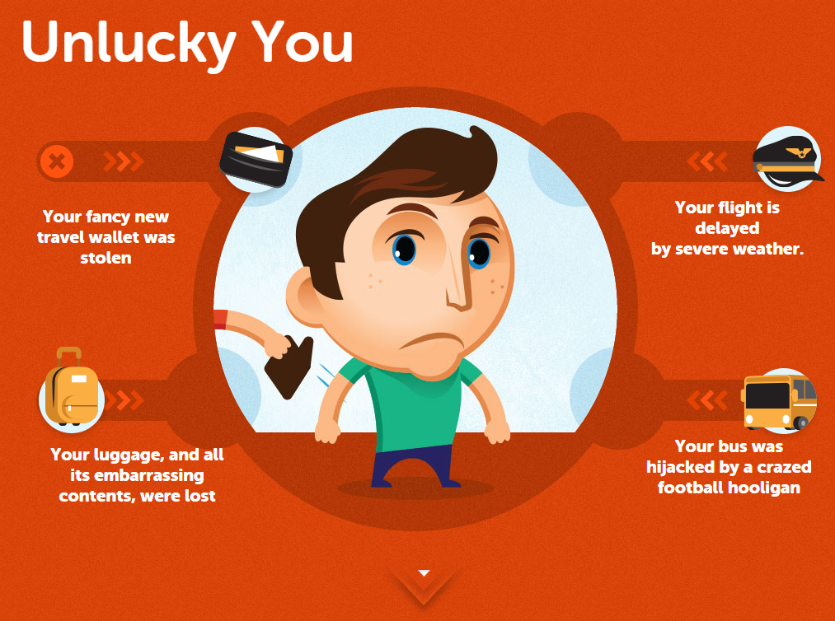

Slide 8
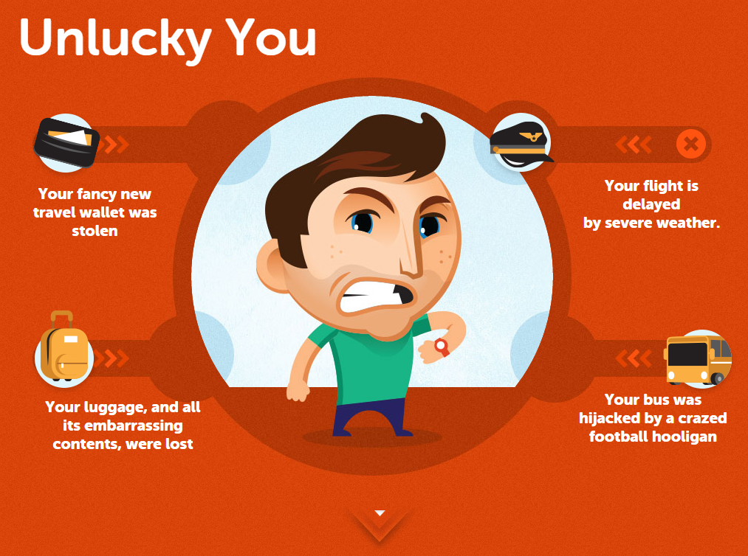

Slide 9
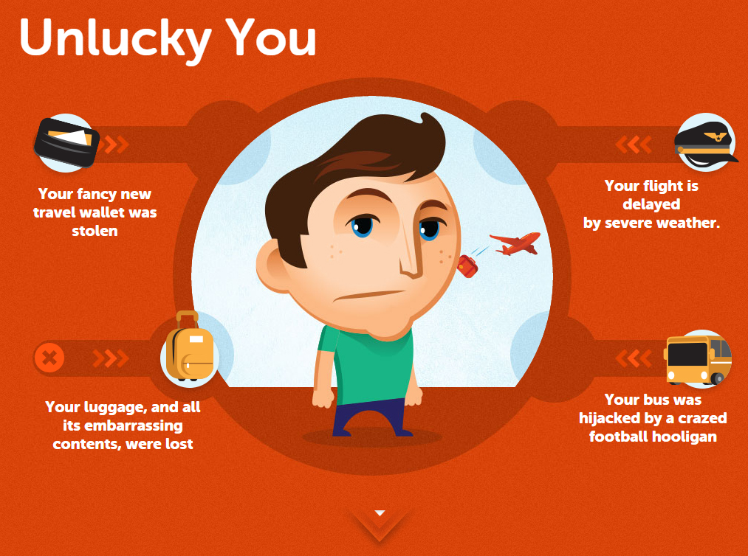

Slide 10
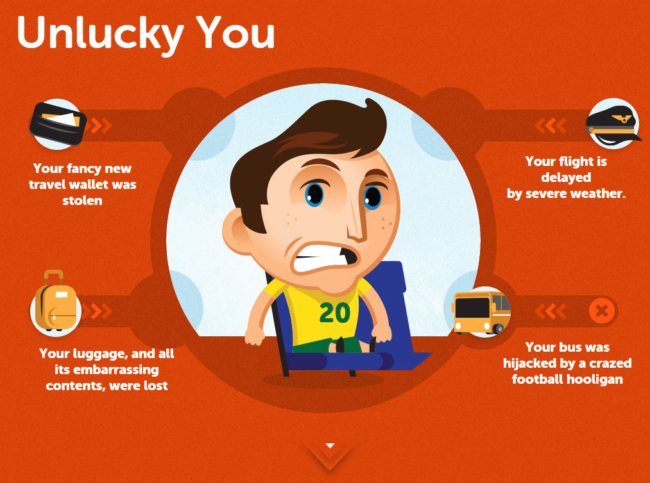

Slide 11
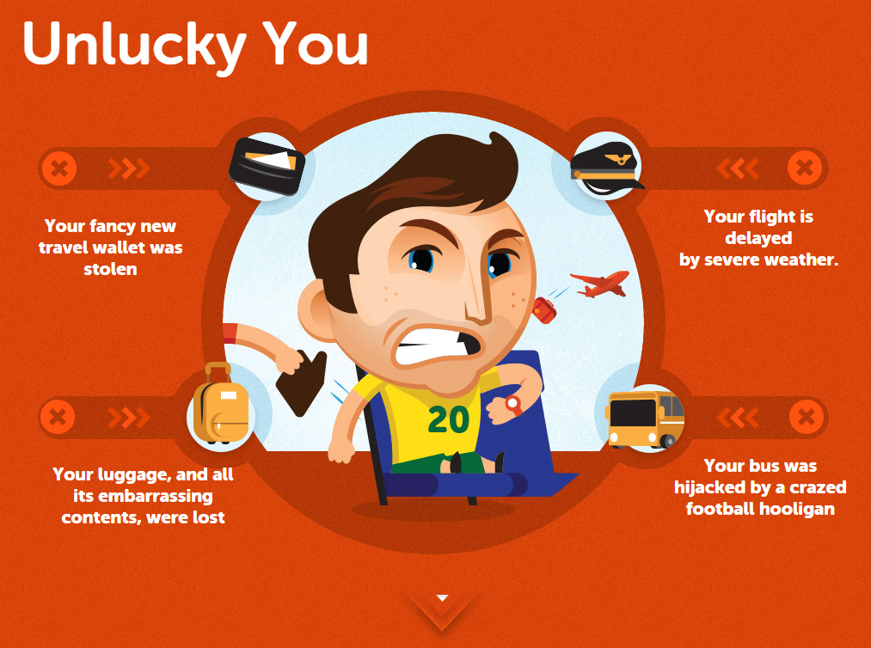

Slide 12
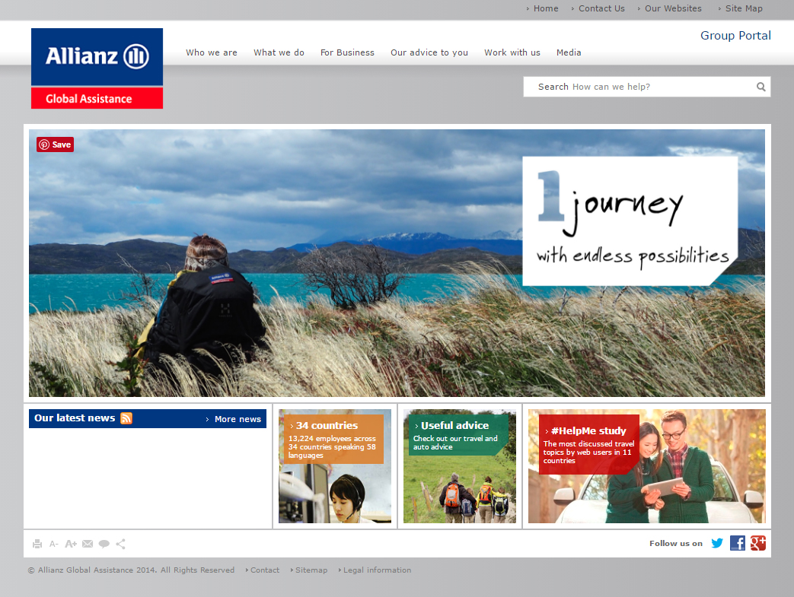

Slide 13


Slide 14
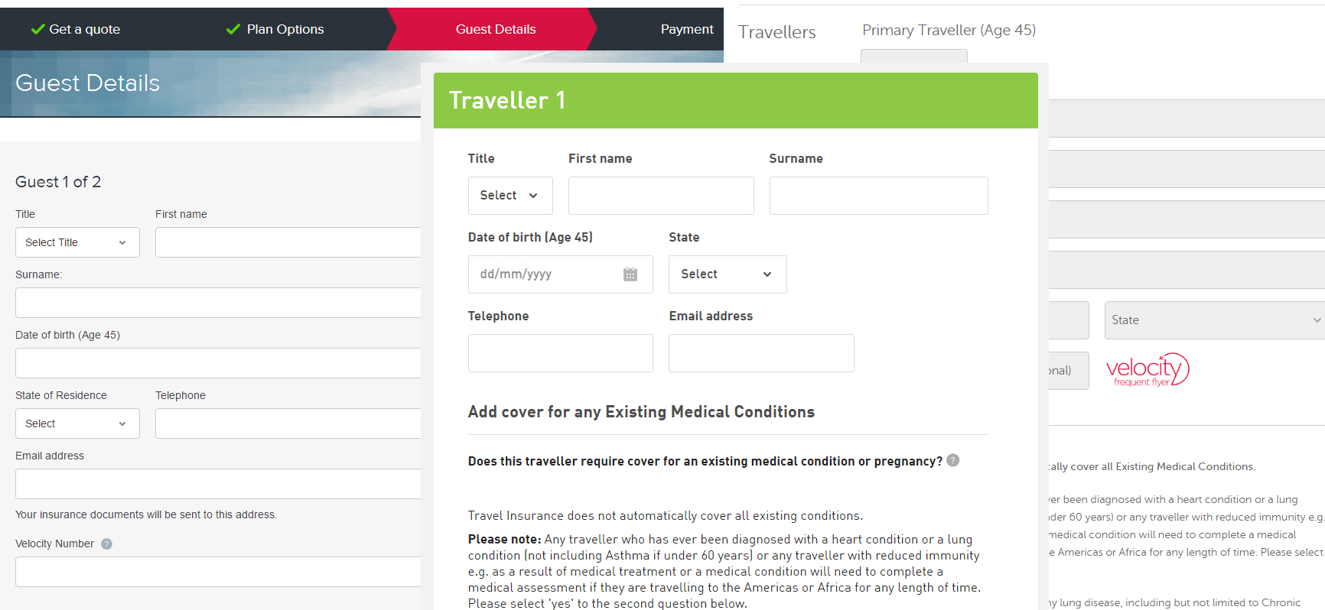

Slide 15
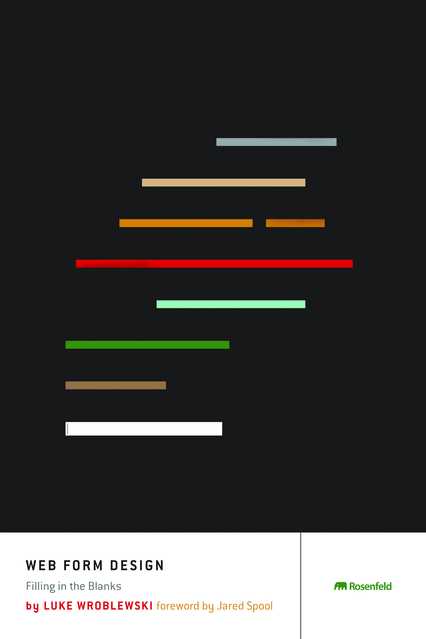

Slide 16
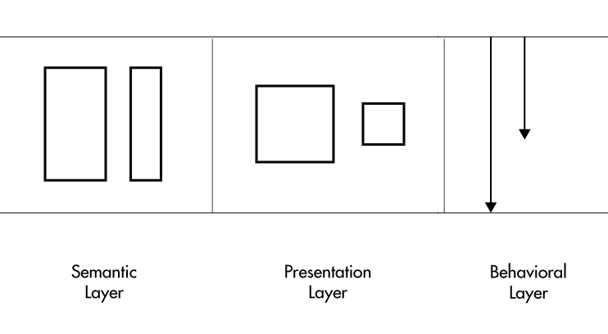

Slide 18
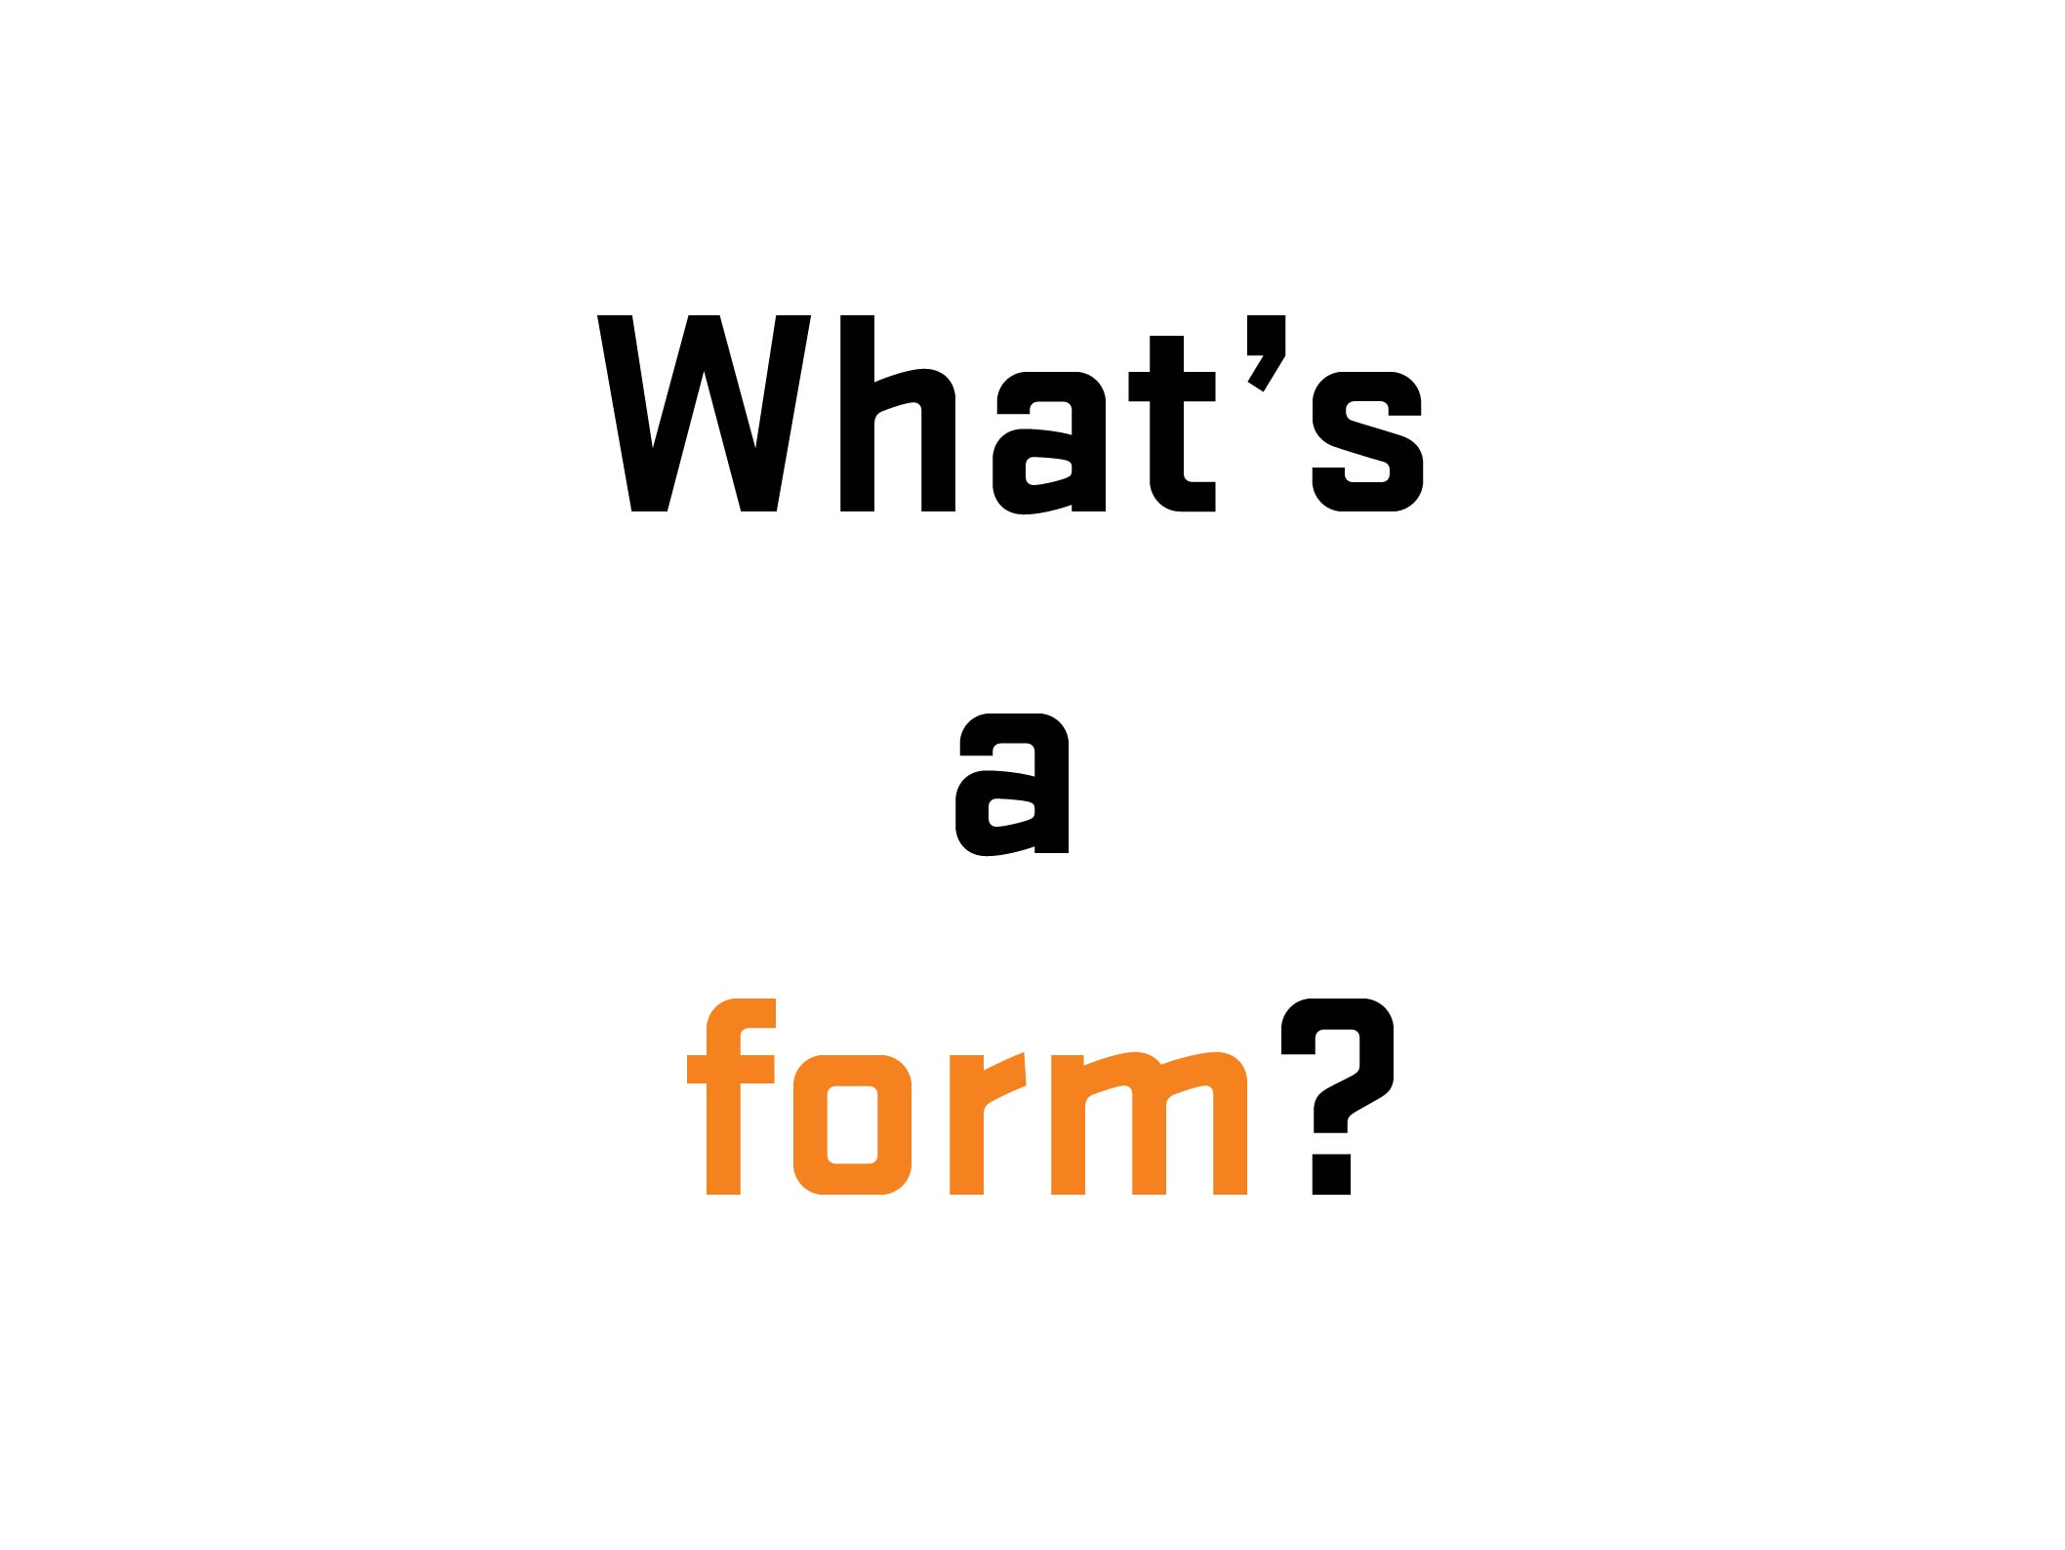

Slide 19
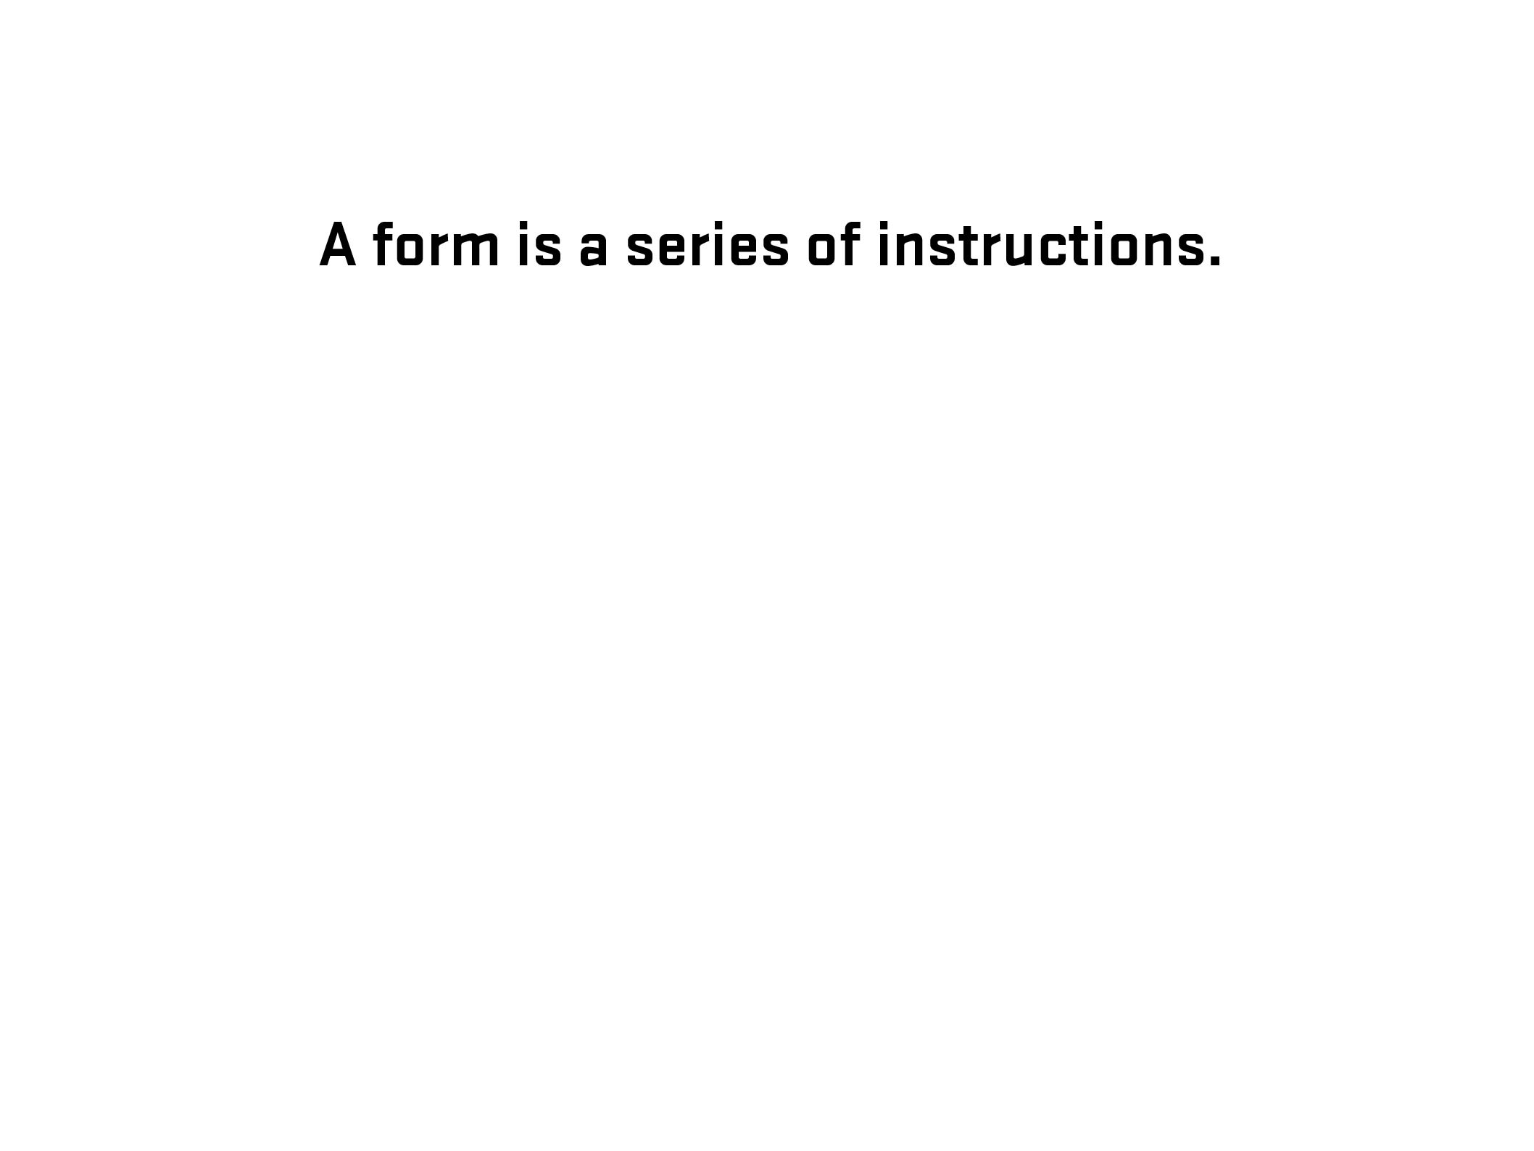

Slide 20
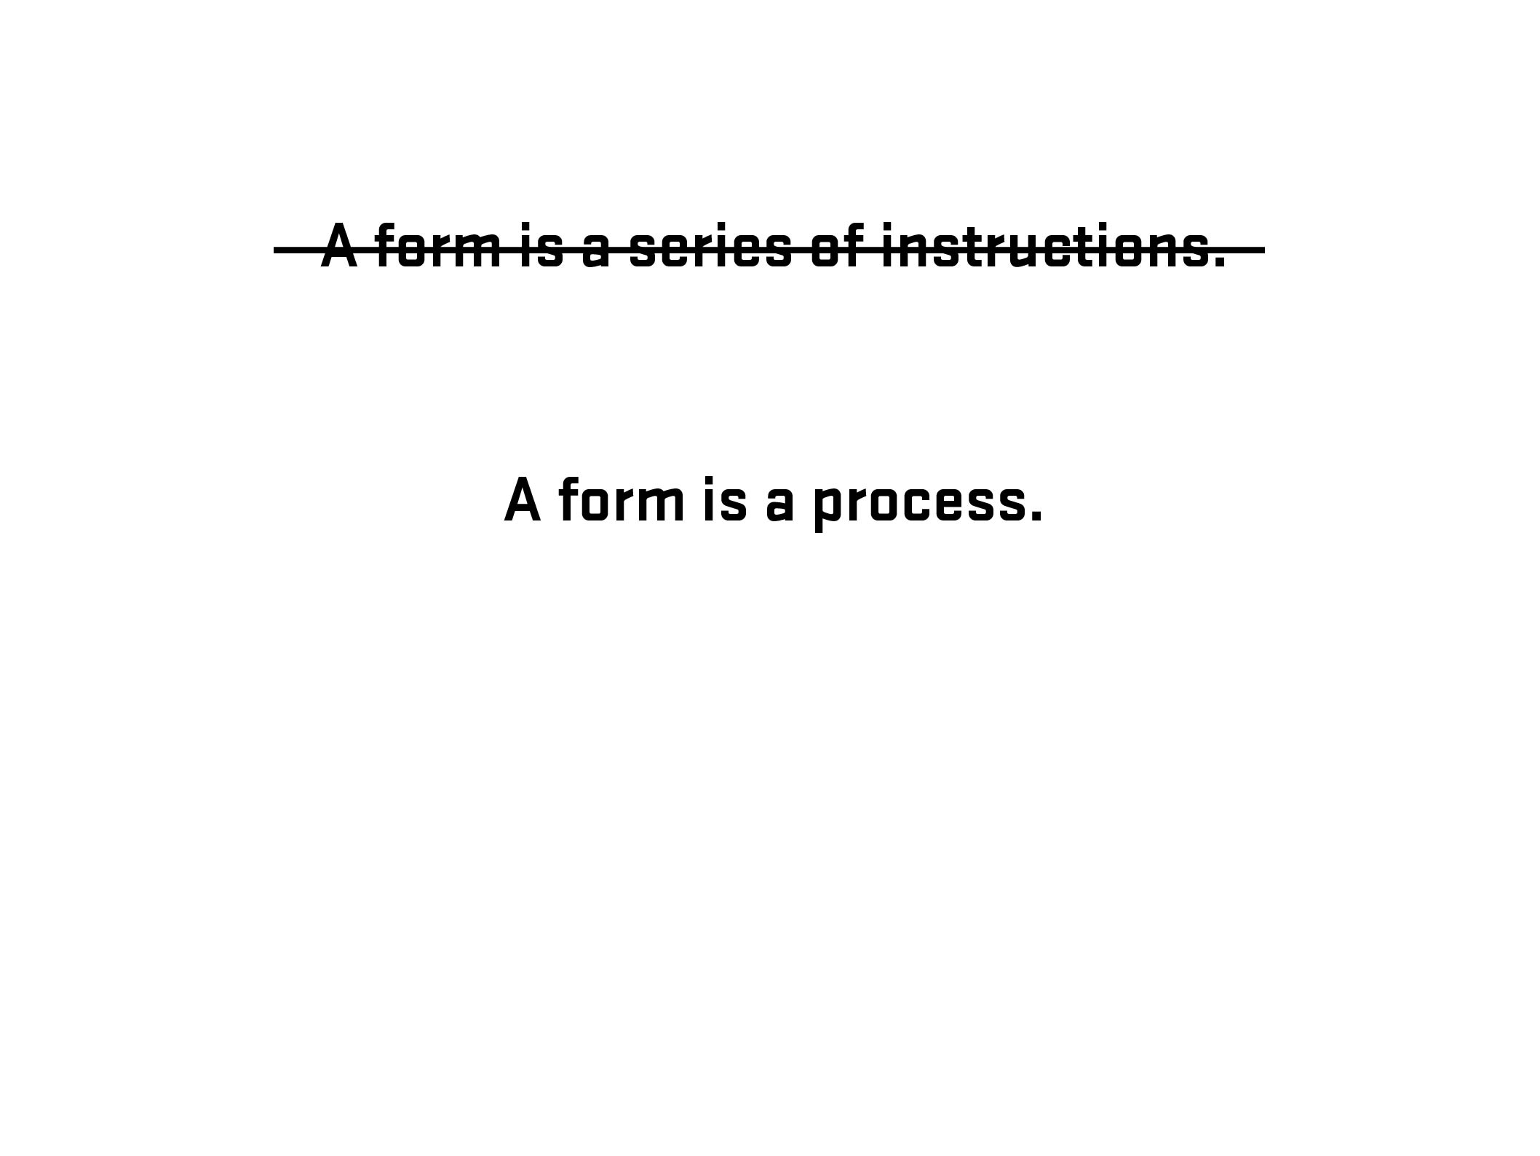

Slide 21
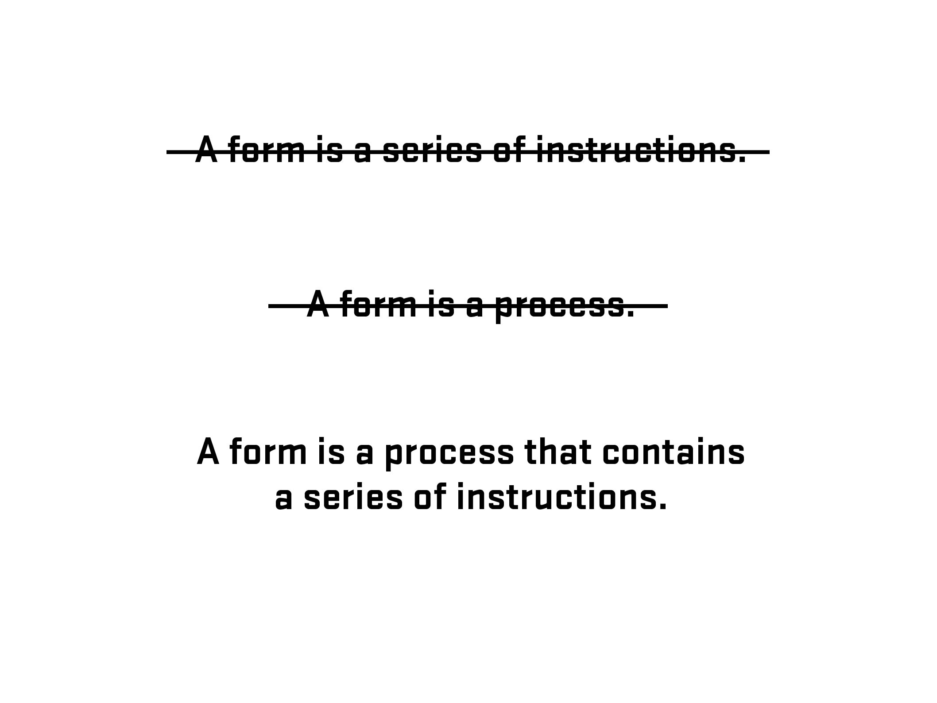

Slide 22
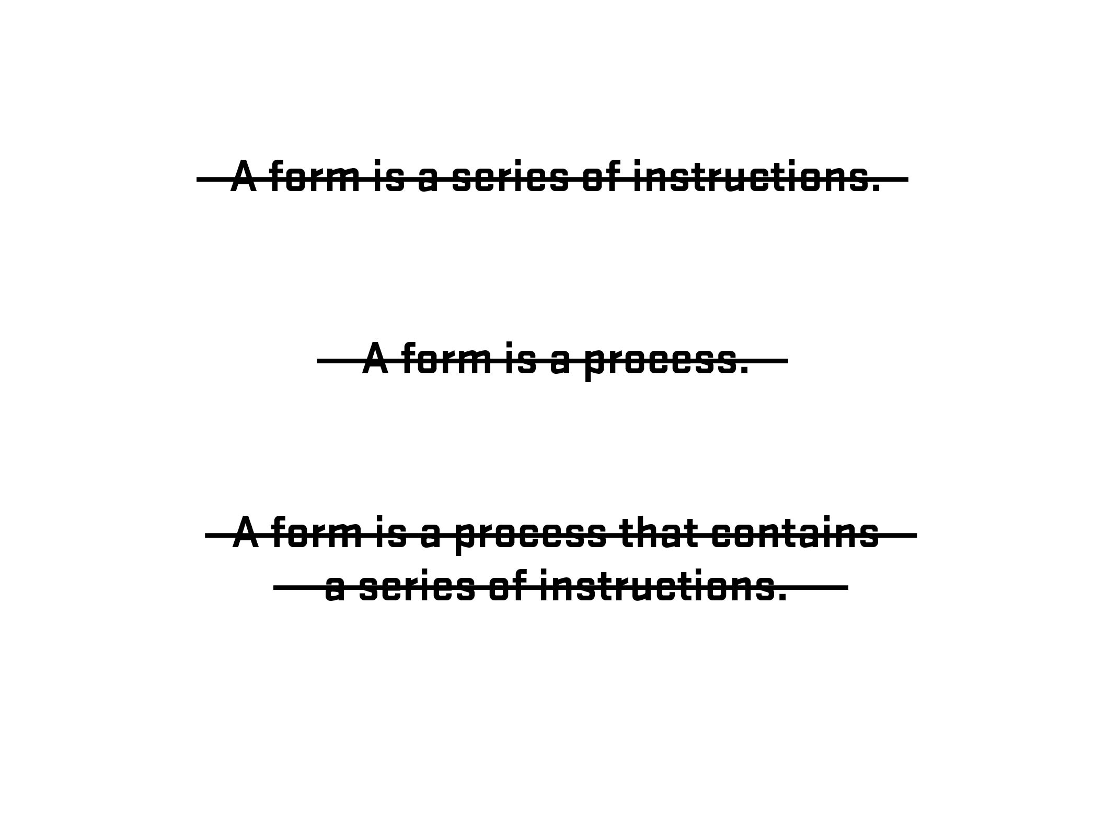

Slide 23
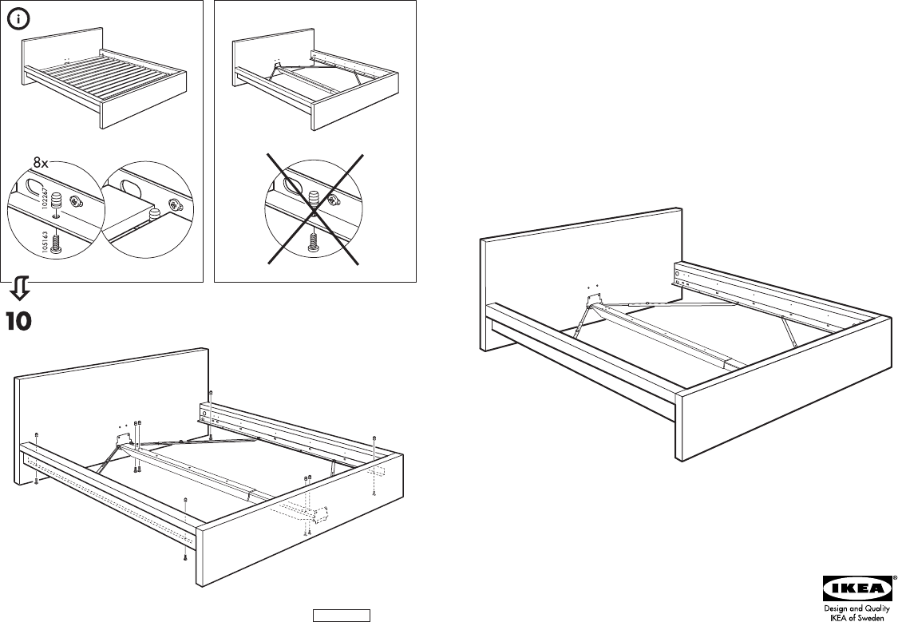

Slide 24

Photo – Space Lab, Vancouver, Canada (Clint Moroz)

Slide 25
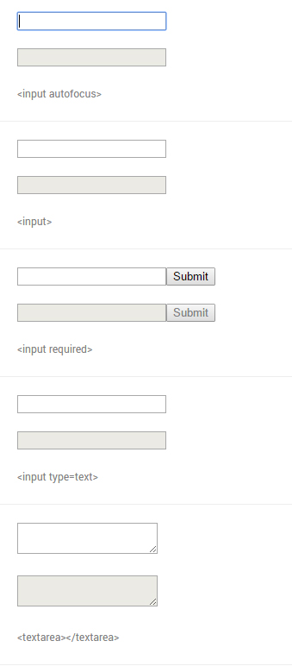
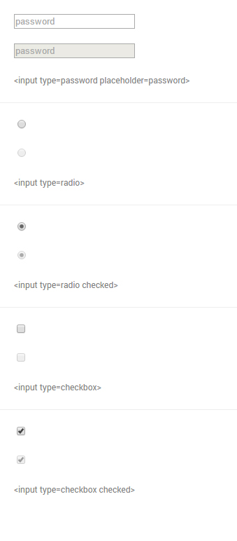
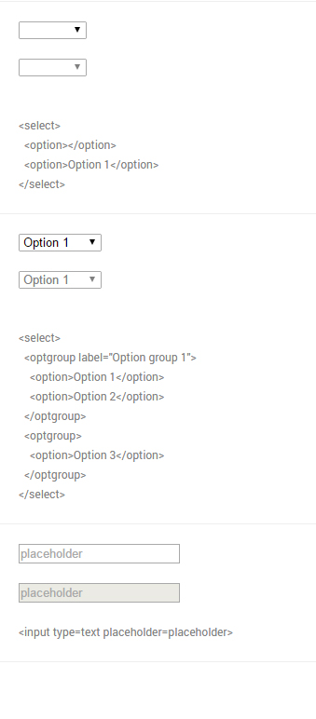
From Native form elements (http://nativeformelements.com/) - Joshua Jenkins

Slide 26
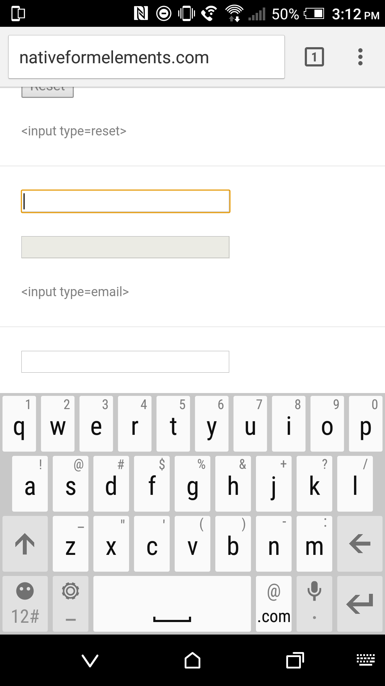
input type=“email”

Slide 27
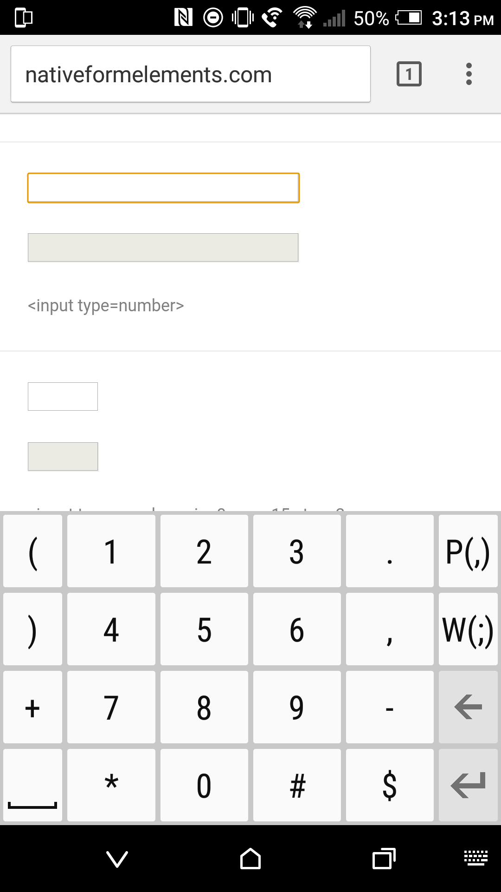
input type=“number”

Slide 28
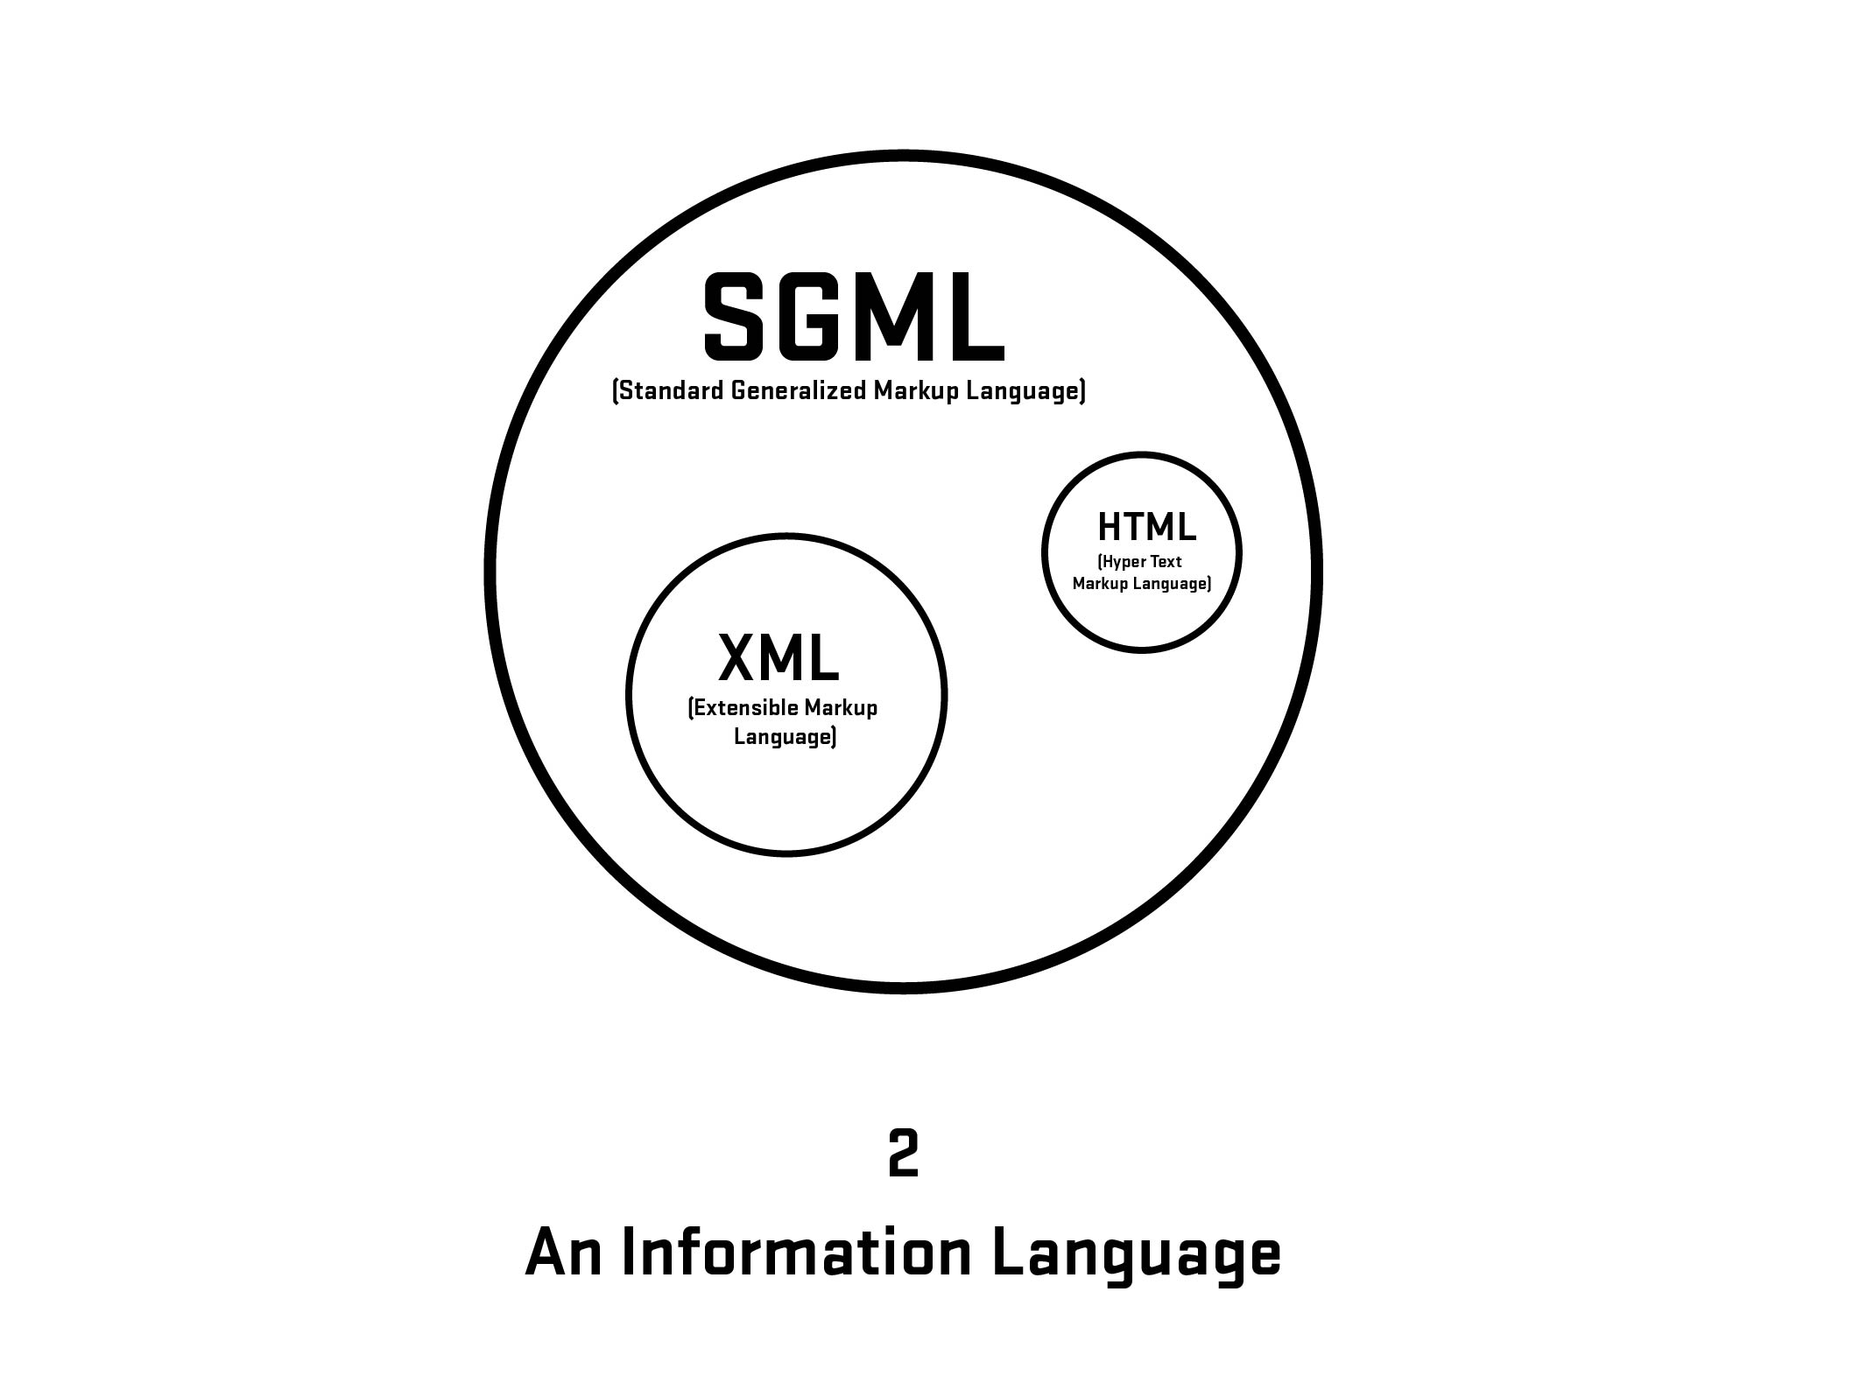

Slide 29
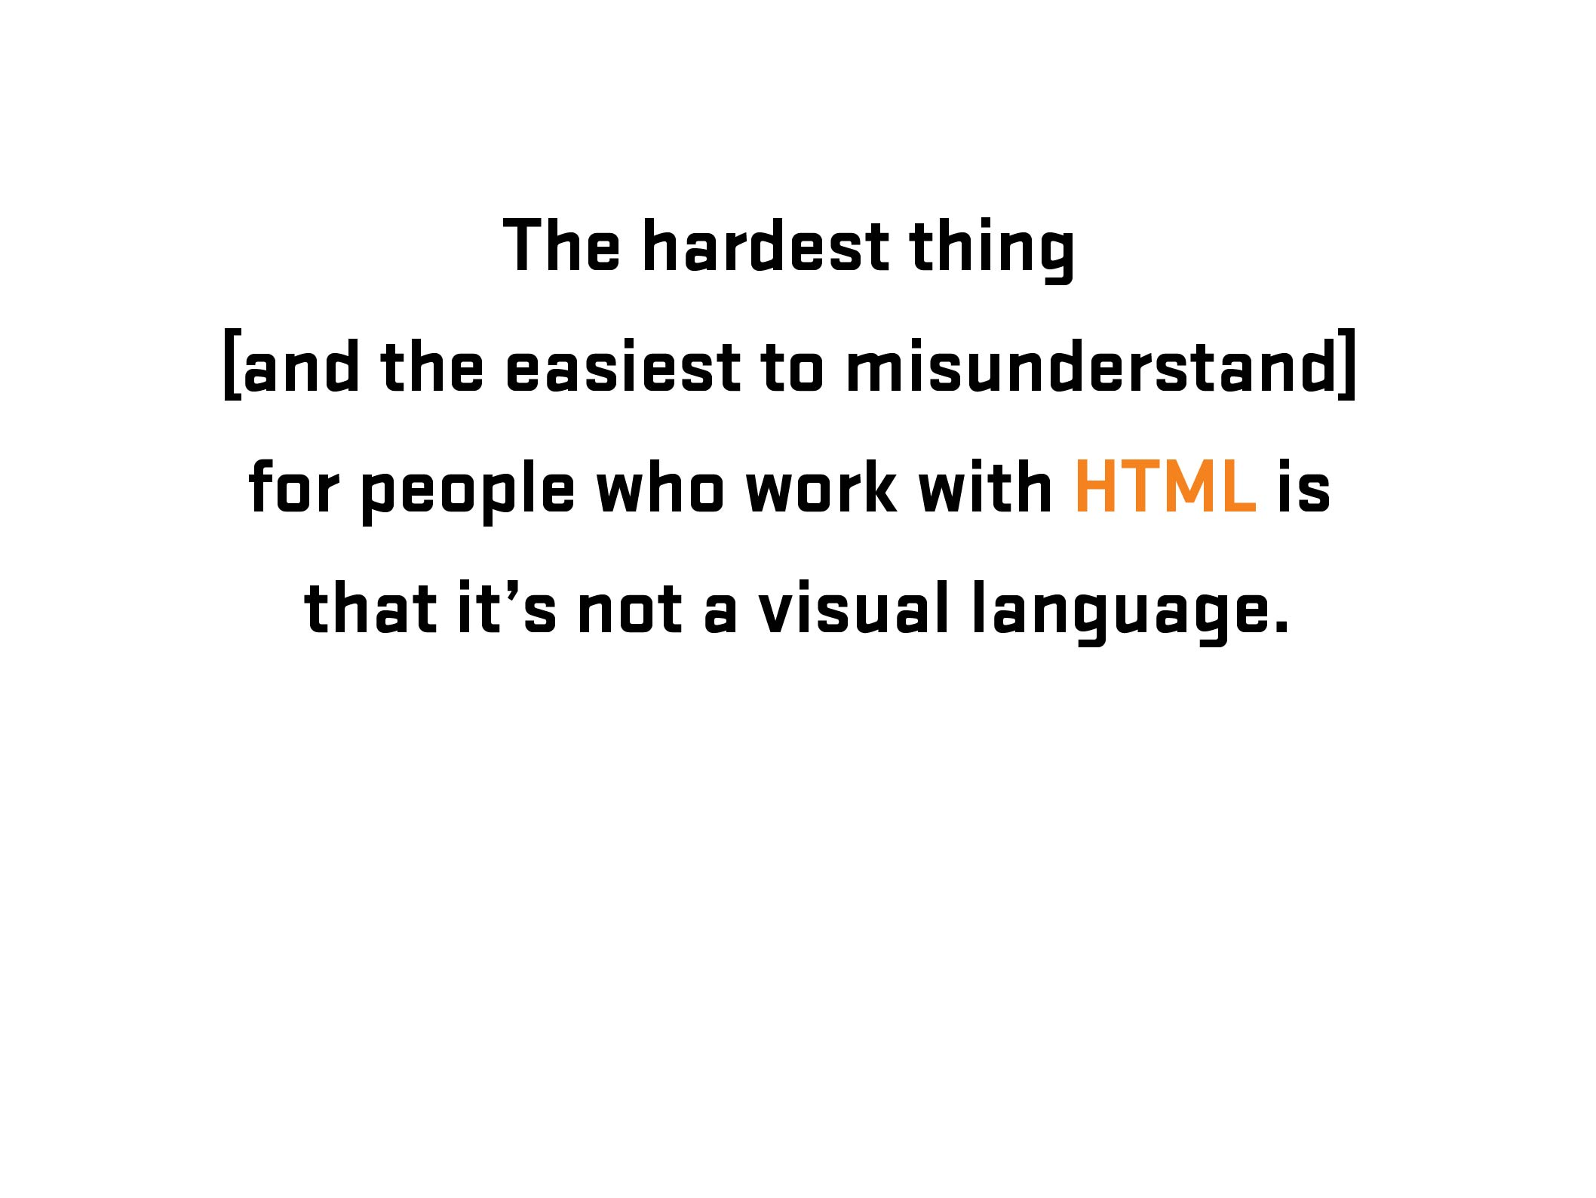

Slide 30
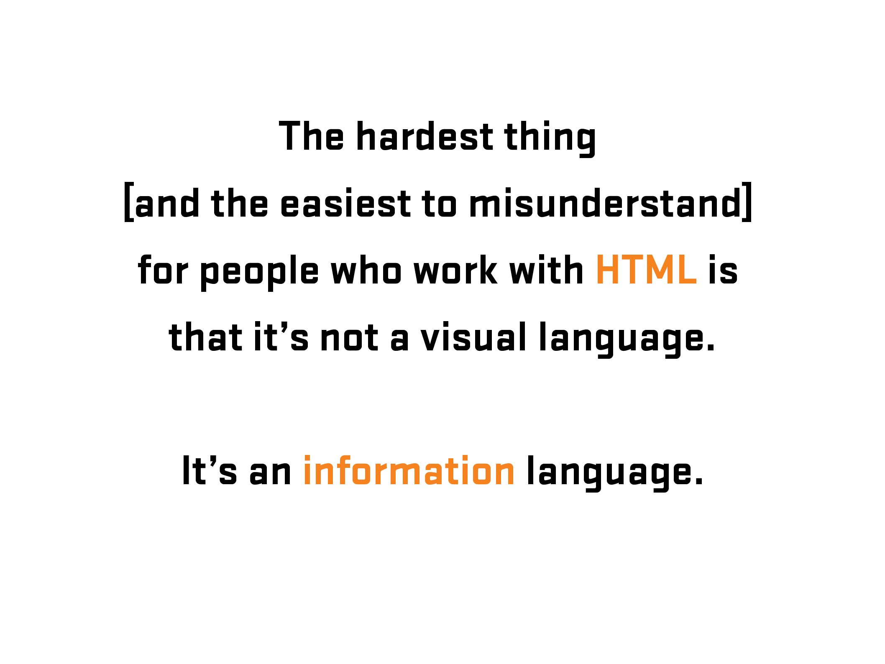

Slide 31

More Information: https://en.wikipedia.org/wiki/Kaieteur_Falls
Notes:
Kaiteur Falls, Guyana

Slide 32

Notes:
Kaiteur Falls, Guyana

Slide 33
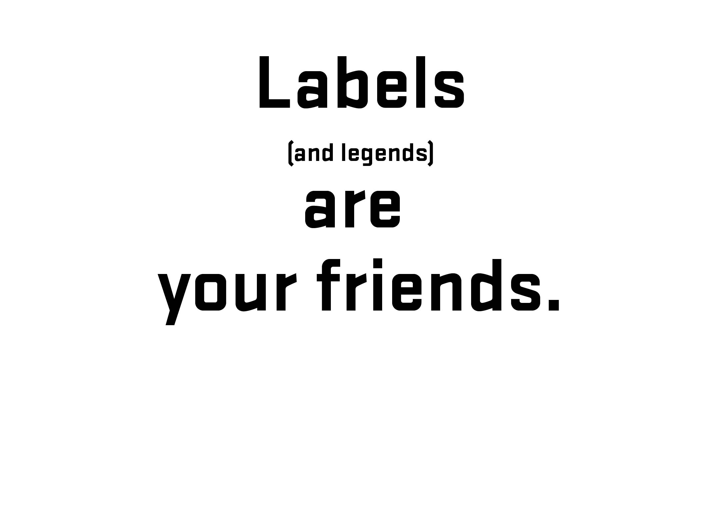
Notes:
Before going further – 1) explain what labels are and 2) what is that difference between placeholder and labels (and why that is important)

Slide 34

Notes:
Before going further – 1) explain what labels are and 2) what is that difference between placeholder and labels (and why that is important)

Slide 35
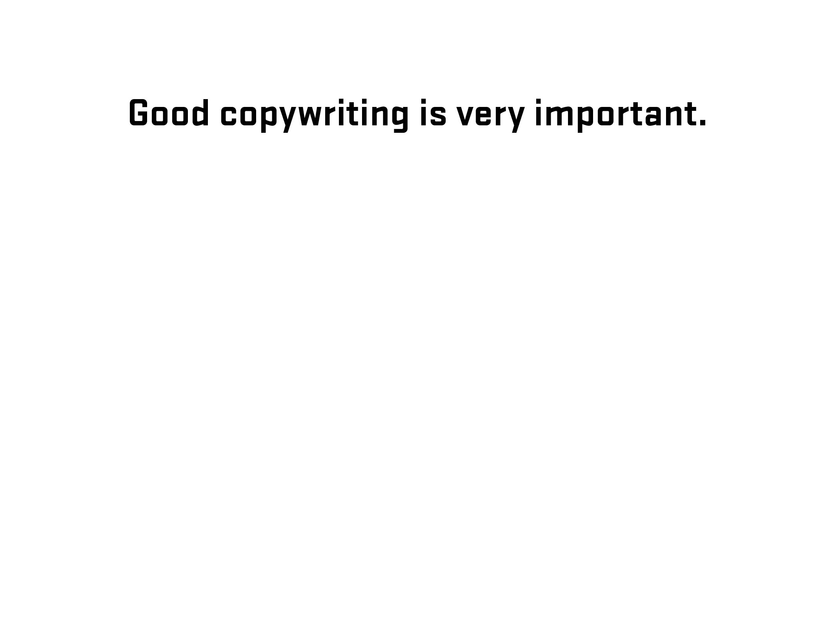
Notes:
Diversion – side note about good writing for labels (copywriting)

Slide 36
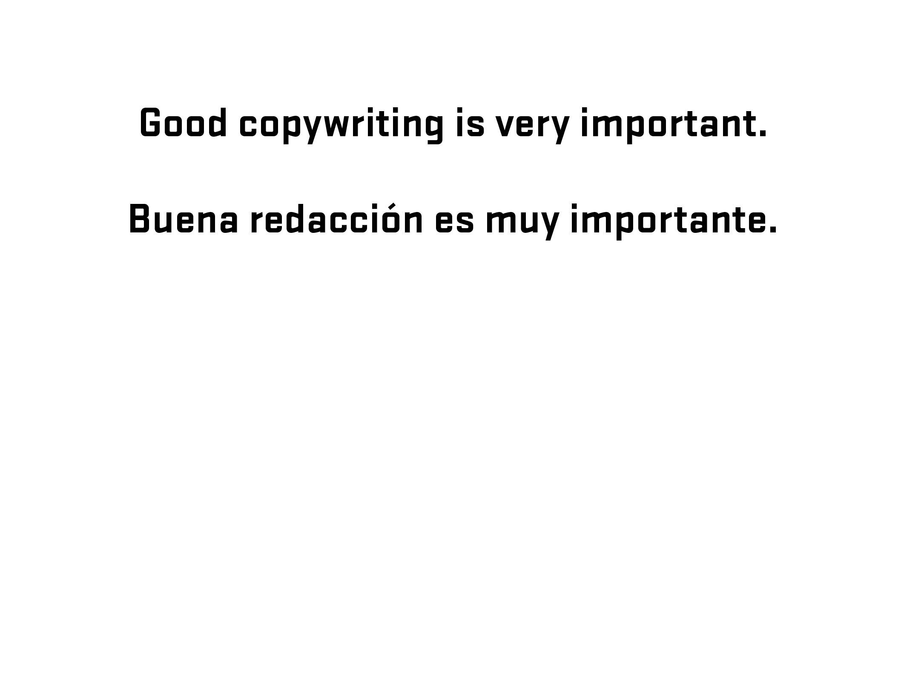
Notes:
Diversion – side note about good writing for labels (copywriting)

Slide 37

Notes:
Diversion – side note about good writing for labels (copywriting)

Slide 38
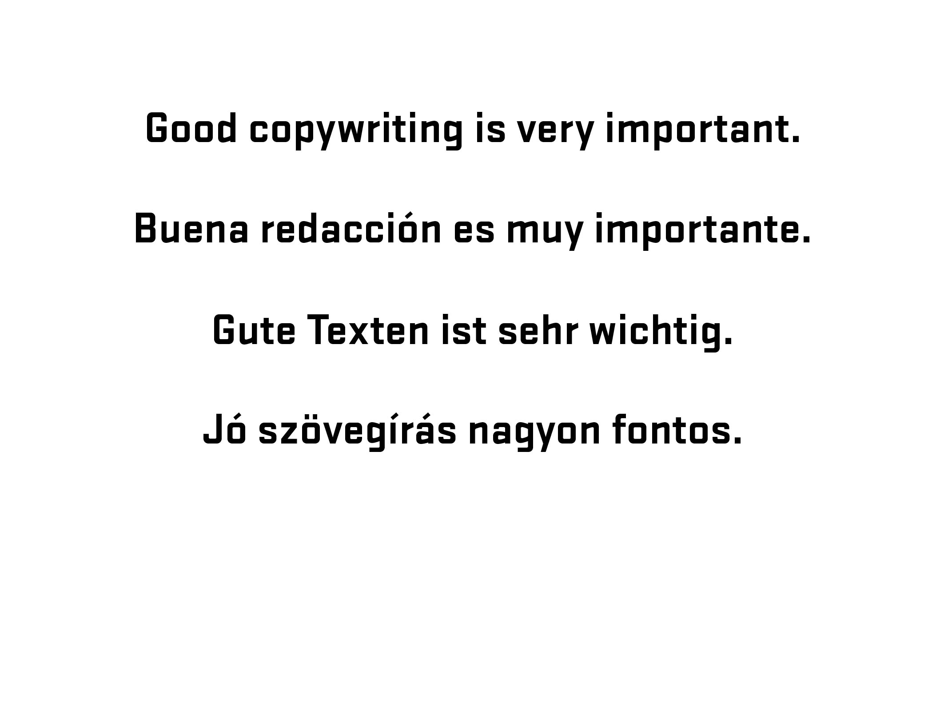
Notes:
Diversion – side note about good writing for labels (copywriting)

Slide 39
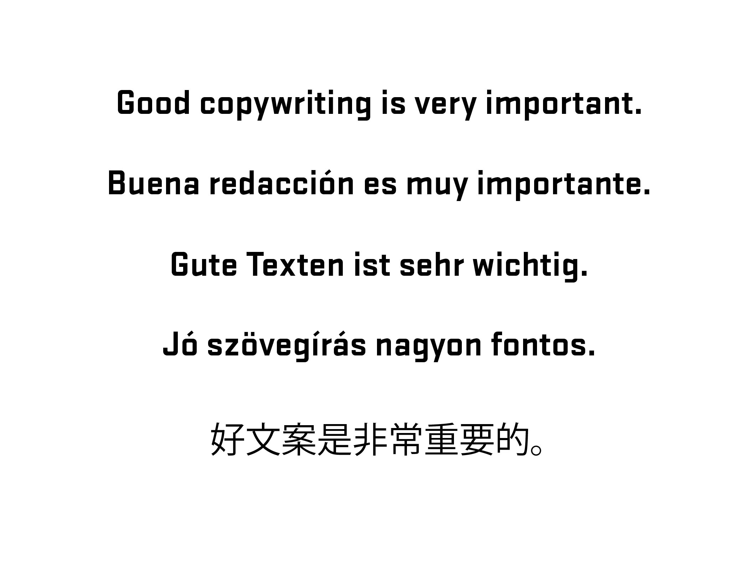
Notes:
Diversion – side note about good writing for labels (copywriting)

Slide 40
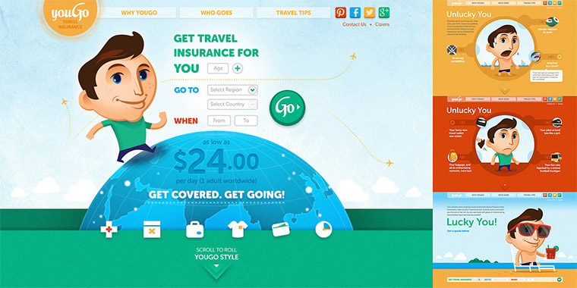
Notes:
youGo – travel insurance for under 30 crowd/Cover-More

Slide 41
Notes:
youGo/unlucky explanation – Visual (Choice #1)
Form with four set of radio buttons – no submit
(demo form)
Go to youGo site for demo - http://yougotravelinsurance.com.au/

Slide 42
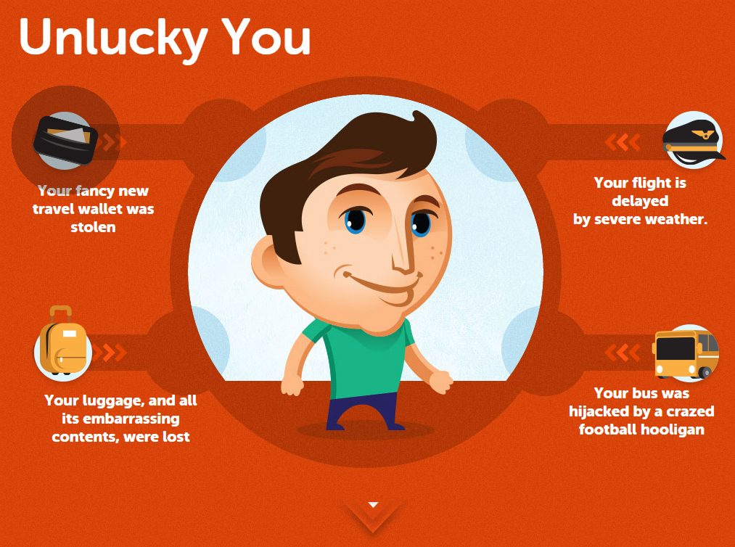
Notes:
youGo/unlucky explanation – Visual/Code (Choice #1)

Slide 43
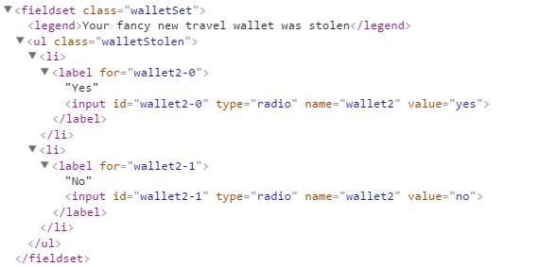
Notes:
youGo/unlucky explanation – Visual/Code (Choice #1)

Slide 44
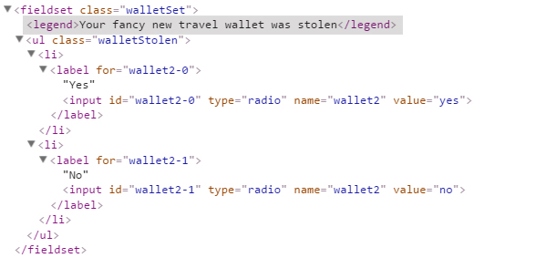
Notes:
youGo/unlucky explanation – Visual/Code (Choice #1)

Slide 45
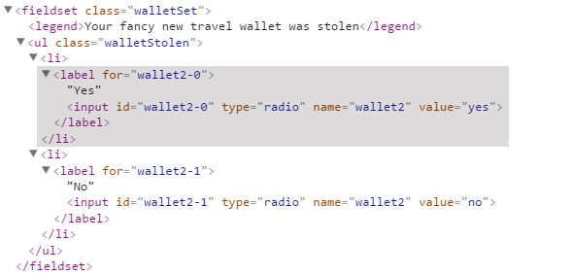
Notes:
youGo/unlucky explanation – Visual/Code (Choice #1)

Slide 46
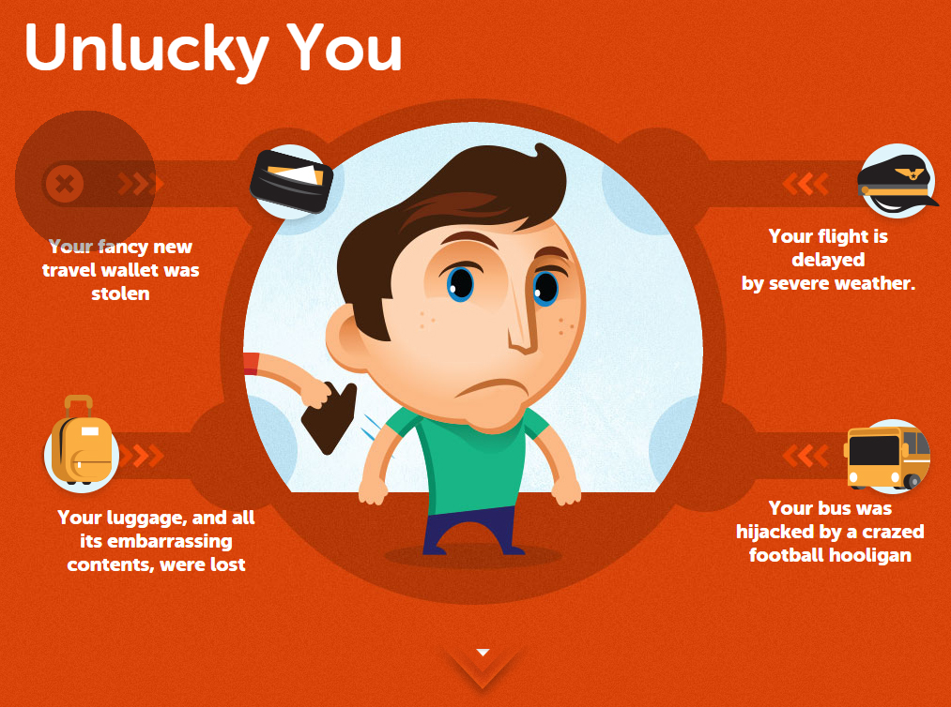
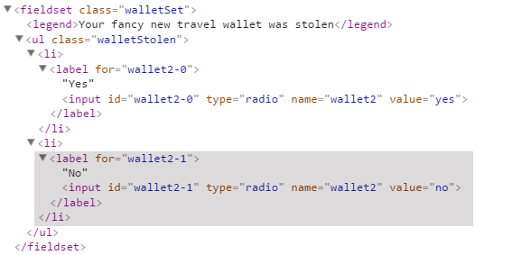
Notes:
youGo/unlucky explanation – Visual/Code (Choice #1)

Slide 47
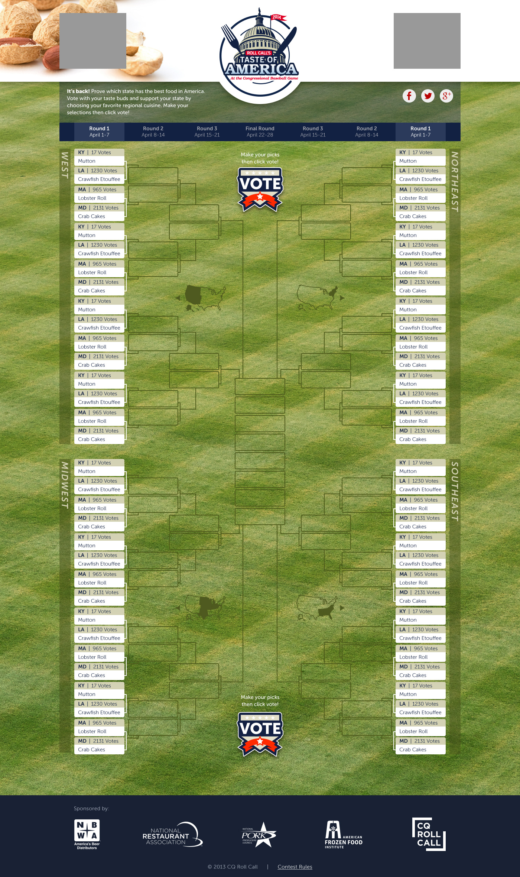

Slide 48
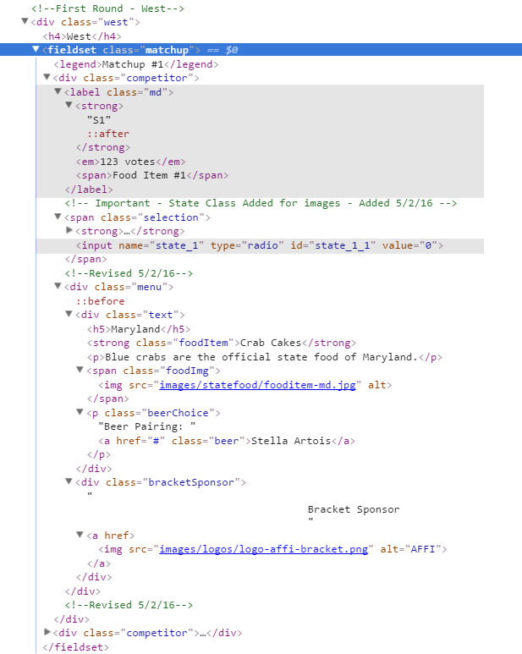
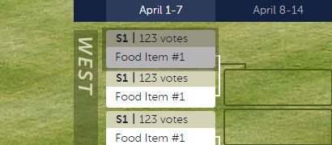
Notes:
One matchup – HTML code
Input is below, hidden unless no js
Go to (live) code example to show the working model

Slide 49
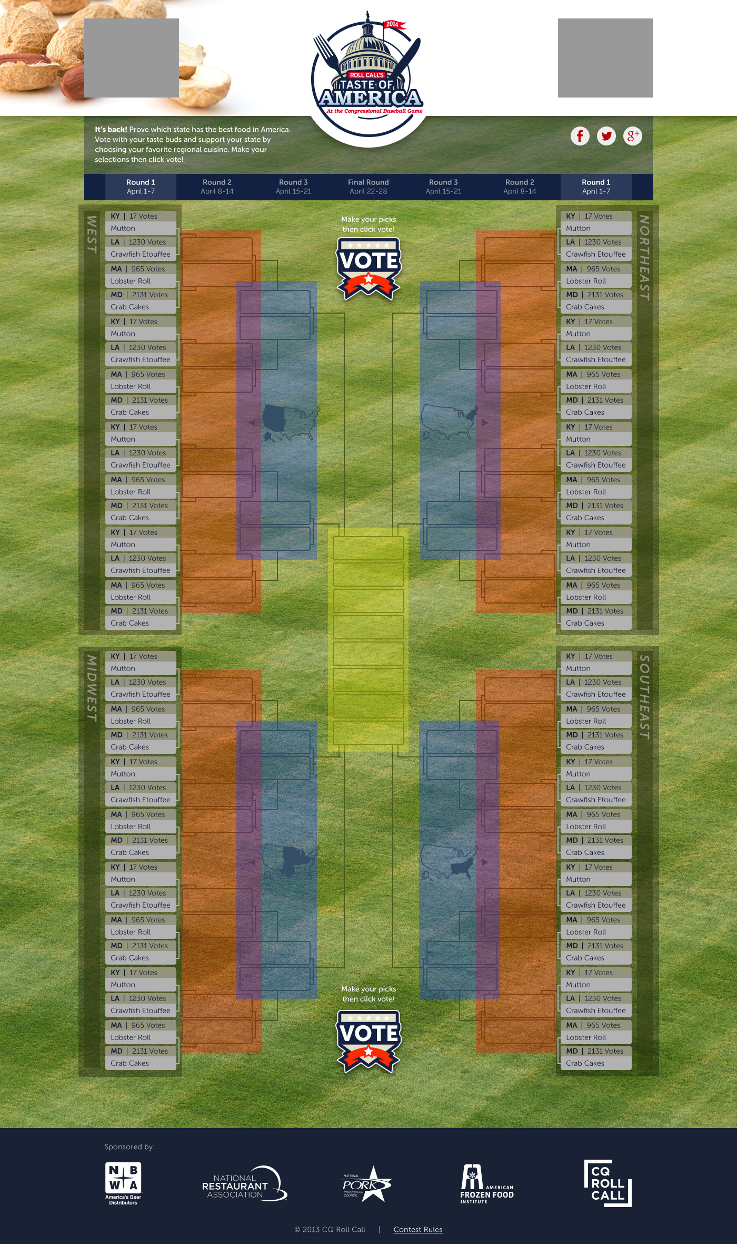

Slide 50
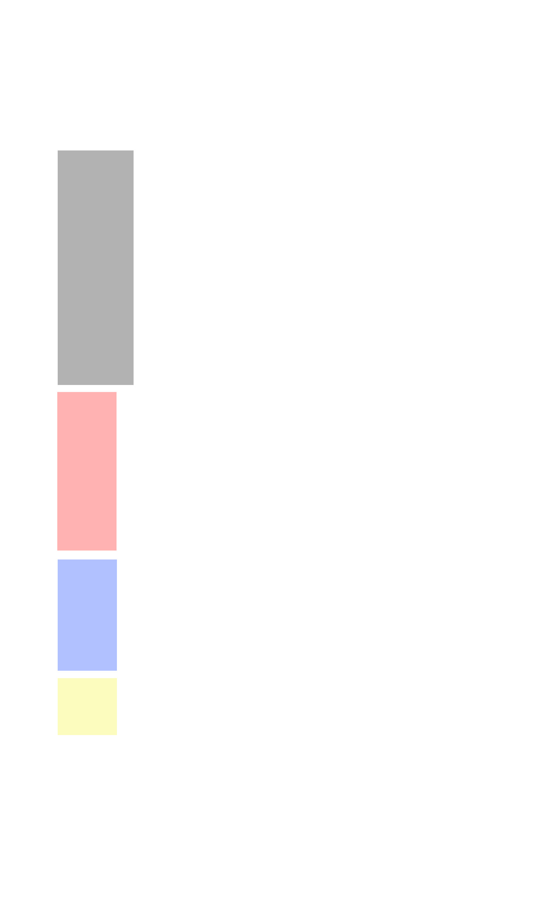
First Round
Second Round
Third Round
Final Round

Slide 51
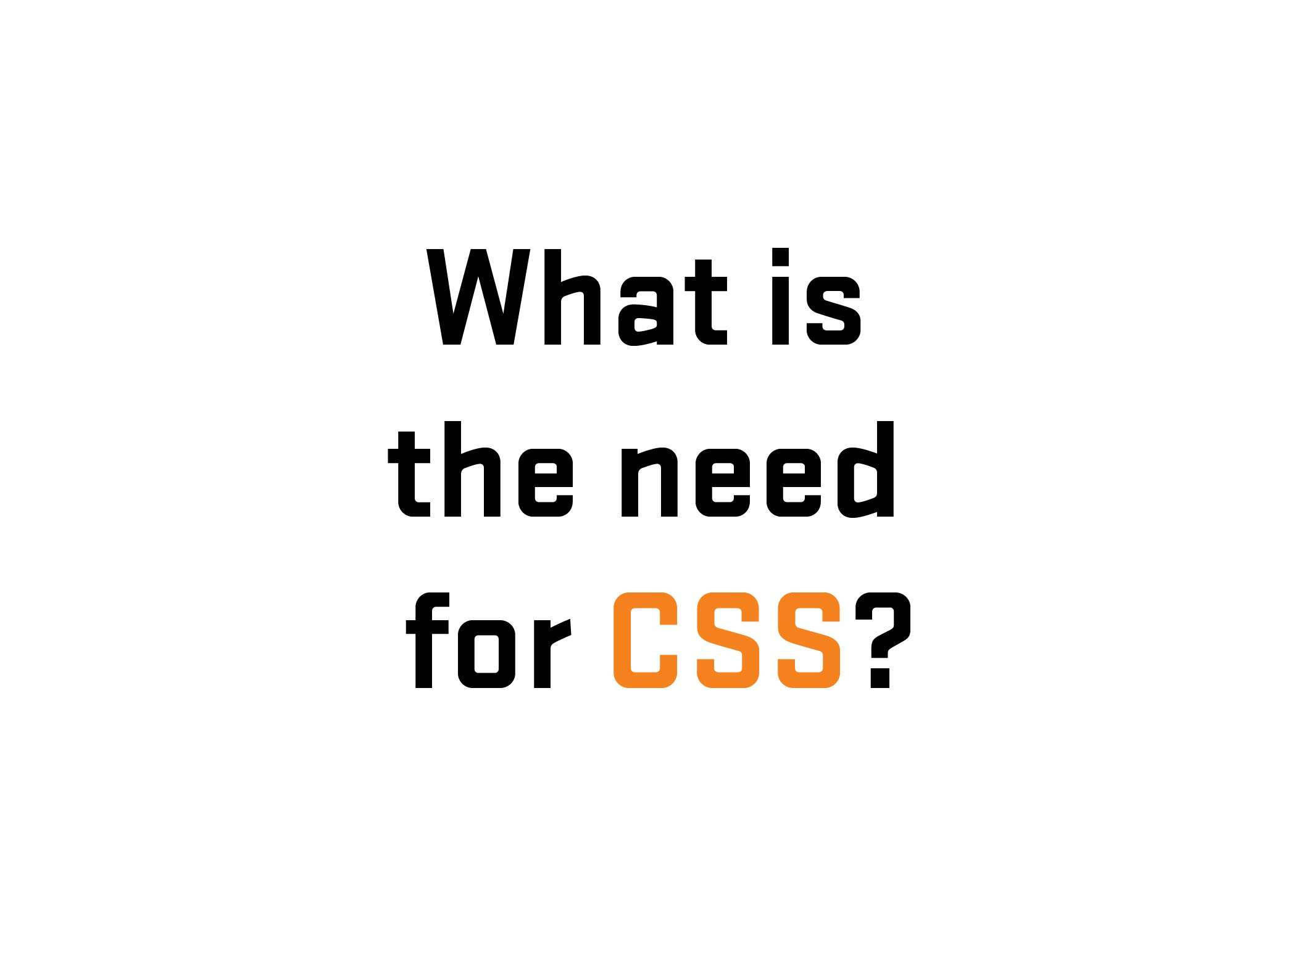

Slide 52
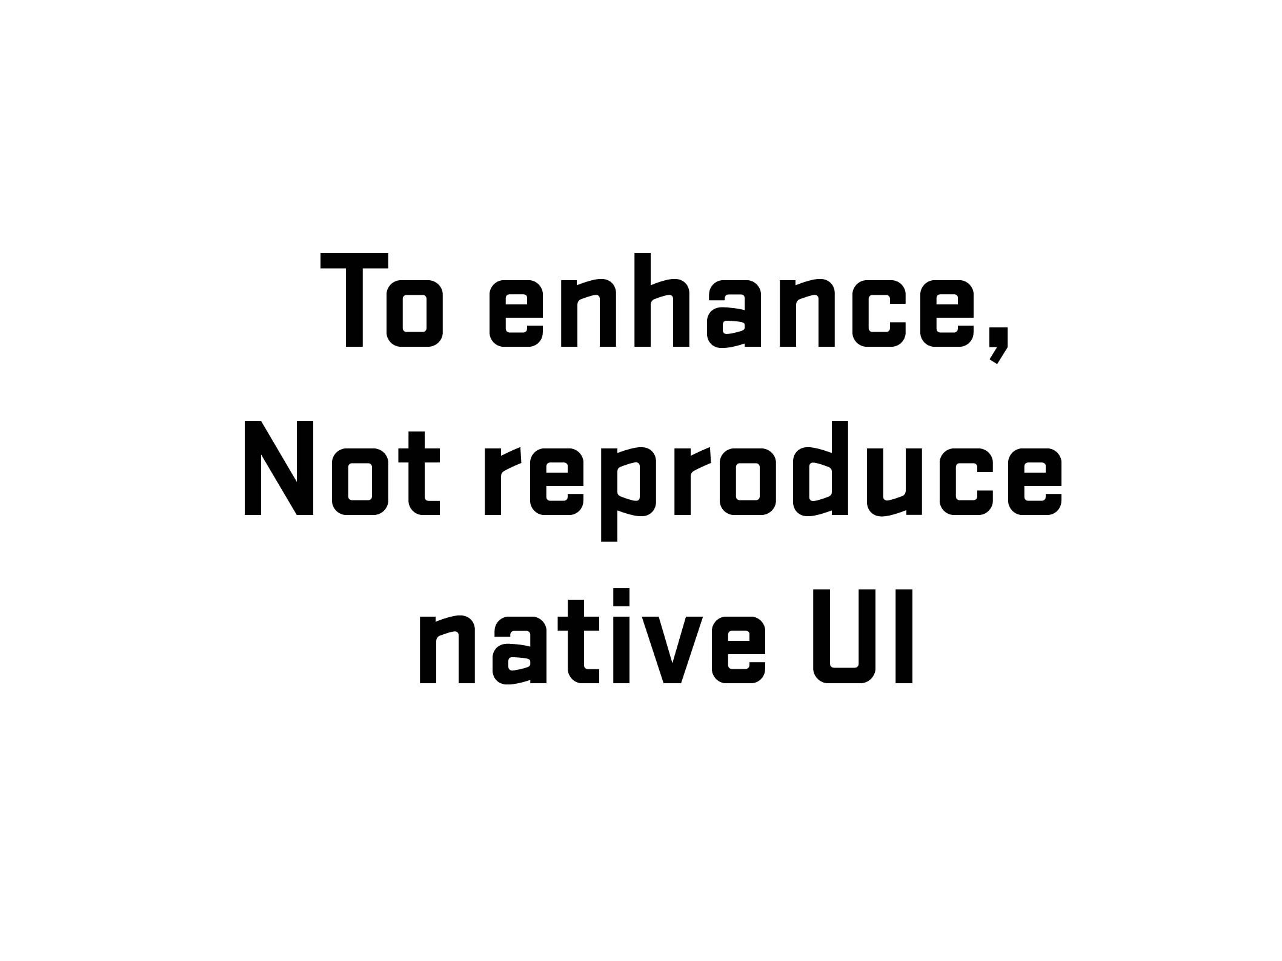
Notes:
Explanation
GEICO Story (2008-09)

Slide 53


Slide 54
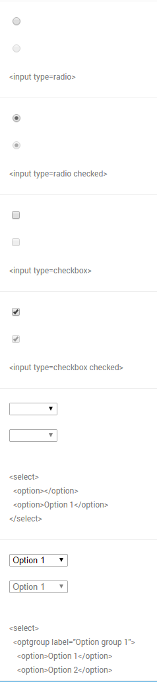
Chrome
Windows 10
Notes:
Differences of form UI’s among browsers/platforms

Slide 55
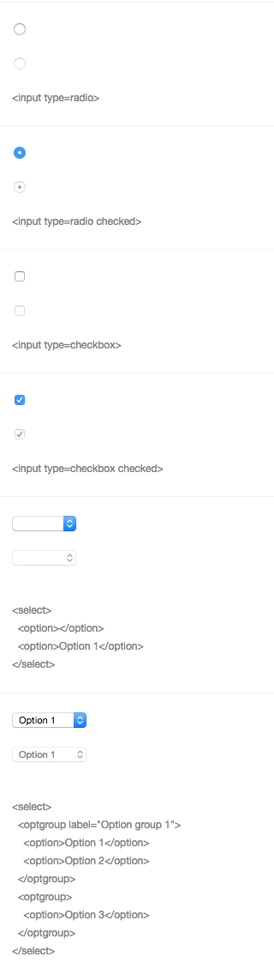
Chrome
Windows 10
Chrome
Yosemite
Notes:
Differences of form UI’s among browsers/platforms

Slide 56
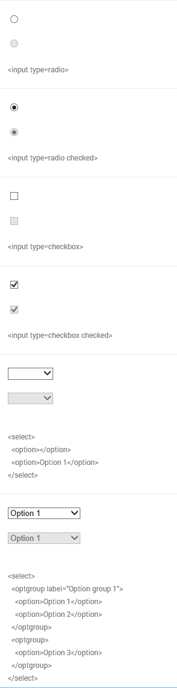
Chrome
Windows 10
Chrome
Yosemite
IE 11
Windows 10
Notes:
Differences of form UI’s among browsers/platforms

Slide 57
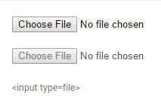
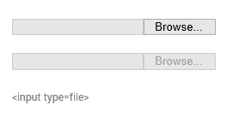
File Input
(Chrome/Firefox/Safari)
File Input
(IE/Edge)
Notes:
Differences of form UI’s among browsers/platforms (mobile)

Slide 58


Chrome
Windows 10
Edge
Windows 10
Notes:
Another example – Date input (different look/functionality/UI) – Desktop
Go to nativeformelements.com for brief demo

Slide 59


iPhone 6S Plus
iOS 9
HTC One M8
Android Marshmellow (6)
Notes:
Another example – Date input (different look/functionality/UI) - Mobile

Slide 60

Notes:
Start story on adding grid from Air NZ to landing page
http://www.airnewzealand.co.nz/travel-insurance/

Slide 61


Slide 62


Slide 63
Notes:
The problem: is the client insisted that we added the grid to our new (responsive) purchase process. But…

Slide 64


Notes:
Yup.

Slide 65

Notes:
Solved problem with two prong/server page approach – one desktop/one mobile. Which is an viable option (see McGrane/adaptive solutions). But at the time, it had hiccups (serving wrong page, etc.). Not a mess but not an ideal (responsive) solution.

Slide 66

Notes:
If I had a chance, what would I do…
So I wrote some notes…

Slide 67


Notes:
First thing, change the codebase (responsive/reduced JS/a11y?)
Allowed for direct data input (no JS)
Single code base (responsive)
A11y???

Slide 68

Notes:
Going back to the base – information language

Slide 69


Slide 70


Slide 71


Slide 72


Slide 73


Slide 74

Notes:
No JS in data entry – used for display/toggle

Slide 75
.ui-countryselector input[type="radio"]
+ label ~ div.columns {
overflow: hidden;
float: none;
position: absolute;
clip: rect(0,0,0,0);
width: 100%;
height: 0;
margin: 0;
padding: 0;
}

Slide 76
.ui-countryselector input[type="radio"]:checked
+ label ~ div.columns {
position: static;
height: auto;
}

Slide 77
.ui-countryselector input[type="radio"] + label ~ div.columns { overflow: auto; }

Slide 78

.ui-countryselector input[type="radio"]:checked + label ~ div.columns { float: left; height: 384px; }
Notes:
Note – hard to do due to bugs. Adjacent bug in both iOS (“+” didn’t work) and Android (needed fix). Thankfully, fixed in more recent versions.

Slide 79
Few bugs exists when starting out two years ago.
CSS/Adjacent Selector – with early versions of Android (<4.2) and iOS (7??) to a lesser degree
But all have disappeared.
Thankfully!
Notes:
I found out during QA testing and was able to remove or work around some of the barriers.

Slide 80

Test!
Notes:
No excuse for not testing – getting problems out of the way. For the initial work, even had to test for Android 2.3…But the way, a moment of silence….

Slide 81
Memorial for Android 2.x testing

Slide 82
JS
/
ARIA

Slide 83
WAI-ARIA
WAI-ARIA (Web Accessibility Initiative – Accessible Rich Internet Applications) is a technical specification published by the World Wide Web Consortium (W3C) that specifies how to increase the accessibility of web pages, in particular, dynamic content and user interface components developed with Ajax, HTML, JavaScript and related technologies.
- Wikipedia (https://en.wikipedia.org/wiki/WAI-ARIA)
Notes:
Brief overview of history/explanation. Go further if needed – refer to W3C.
Need list of resources for audience

Slide 84
ARIA Landmark Roles
Notes:
Quick explanation of landmark roles. Using in combination with HTML (not duplicating)

Slide 85
aria-live = [off, polite, assertive, rude]
aria-describedby = [element id]
aria-labelledby = [element id]

Slide 86


Slide 87


Slide 88


Slide 89


Slide 90


Slide 91
HTML
CSS
JS/ARIA
Notes:
Referencing Project Ottawa – three layers, translated into a) HTML, b) CSS, c) JS/ARIA
The FED toolbox for building experiences.

Slide 92


Slide 93
Thank You!
Ivan Wilson
Innate
CSS Dev Conference
San Antonio, Texas
October 17-19, 2016

